Slide 1
VSCode and Docker

Slide 2
Container-based Development
There are advantages to using container-based technology, especially Docker, to significantly improve software quality through repeatable builds.

Slide 3
Prerequisites
Docker is installed – Install Docker Engine
The VSCode extension Remote – Containers is installed
VSCode

Slide 4
Options...
There are several different approaches to using Dev Containers. Here are three options:
Using an existing Docker image from Docker Hub
Using a pre-build Microsoft container setup
Using a custom Docker image based on a project specific Dockerfile

Slide 5
Knowledge of Docker
Container
Container Image
Container Registry

Slide 6
What Are Containers?
Containers offer a logical packaging mechanism in which applications are abstracted from the environment in which they actually run.
This decoupling allows container-based applications to be deployed easily and consistently.
The target environment may be:
private data center
public cloud
developer’s desktop machine or personal laptop
QA, staging, production environment
moved between cloud providers

Slide 7
A Clean Break
Containerization provides a clean separation of concerns:
Developers can focus on their application logic and dependencies.
IT operations teams can focus on deployment and management.
(Without bothering with application details such as specific software versions and configurations specific to the application.)

Slide 8
Containers vs Virtualization
Instead of virtualizing the hardware stack as with the virtual machines approach, containers virtualize at the operating system level, with multiple containers running atop the OS kernel directly.
Containers are:
Far more lightweight since they share the OS kernel
Start much faster
Use a fraction of the memory compared to booting an entire OS.

Slide 9
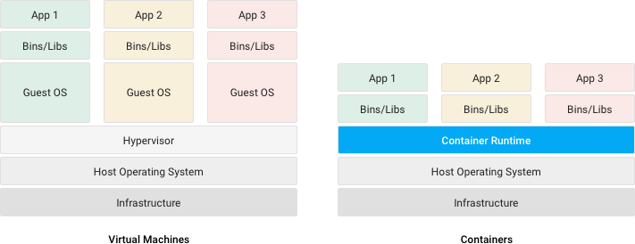
Containers vs Virtualization
Image from Google Cloud

Slide 10
Developer Advantages
Jump between Python 2.7 and 3.6
Install dependent libraries on a clean machine image
Is not affected by installs made on your local machine (for other projects)
Can create an image which can be shared among team members – this keeps your local machine free and clear of any downloads or dependencies that may be loaded over time

Slide 11
Container Image
A container image is an unchangeable, static file that includes executable code so it can run an isolated process on a containerization platform such as Docker.
The image is comprised of:
system libraries
system tools
platforms settings a software program needs to run
A container image is compiled from file system layers built onto a parent or base image.

Slide 12
Types of Container Images
A container image may be hand built.
A user creates a container image from scratch with the build command of a container platform, such as Docker.
Each command in the Dockerfile creates a new layer in the image.
Obtain a vendor image.
Many software vendors create publicly available images of their products.

Slide 13
Container Image Warning
You should be aware of the existence of corrupt, fake and malicious publicly available container images, sometimes disguised to resemble official vendors' images.
The Docker Content Trust feature relies on digital signatures to help verify that images files downloaded from public repositories are original and unaltered.

Slide 14
Docker Desktop
Docker Desktop is an easy-to-install application for your Mac or Windows environment that enables you to build and share containerized applications and microservices.
Docker Desktop includes:
Docker Engine
Docker CLI client
Docker Compose (a tool for defining and running multi-container Docker applications)
Notary (a tool for publishing and managing trusted collections of content)
Kubernetes (a portable, extensible, open-source platform for managing containerized workloads and services)
Credential Helper (a suite of programs to use native stores to keep Docker credentials safe)

Slide 15
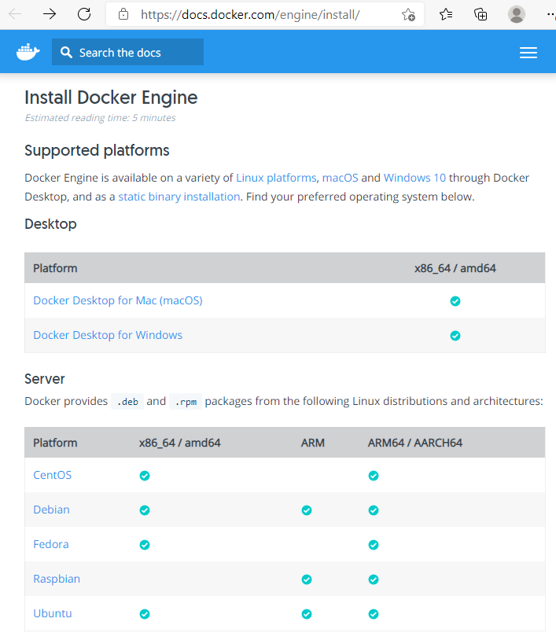
Docker Support

Slide 16
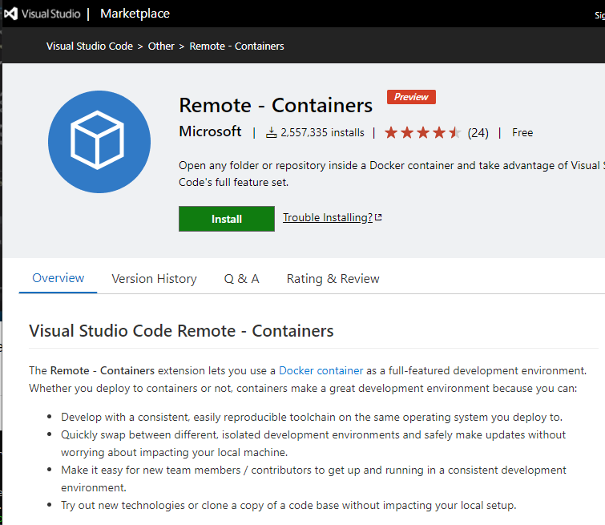
Remote Containers Extensions

Slide 17
VSCode
Visual Studio Code is a free source-code editor made by Microsoft for Windows, Linux and macOS.
Features include:
support for debugging
syntax highlighting
intelligent code completion
Snippets
code refactoring
embedded Git
Users can change the theme, keyboard shortcuts, preferences, and install extensions that add additional functionality.

Slide 18
VSCode is Popular
Microsoft has released Visual Studio Code's source code on the microsoft/vscode repository of GitHub, under the permissive MIT License, while the releases by Microsoft are freeware.
In the Stack Overflow 2019 Developer Survey, Visual Studio Code was ranked the most popular developer environment tool, with 50.7% of 87,317 respondents reporting that they use it.

Slide 19

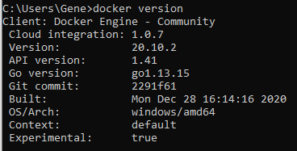
Docker is Running
Make sure that Docker is running by checking your computer's 'status' area for the Docker container logo.
Or, execute the 'docker version' command from your command line.
Otherwise, you will see a connection error.

Slide 20
One Last Thing... Git
Git is the most commonly used version control system.
Git tracks the changes you make to files, so you have a record of what has been done, and you can revert to specific versions should you ever need to.
Git also makes collaboration easier, allowing changes by multiple people to all be merged into one source.

Slide 21
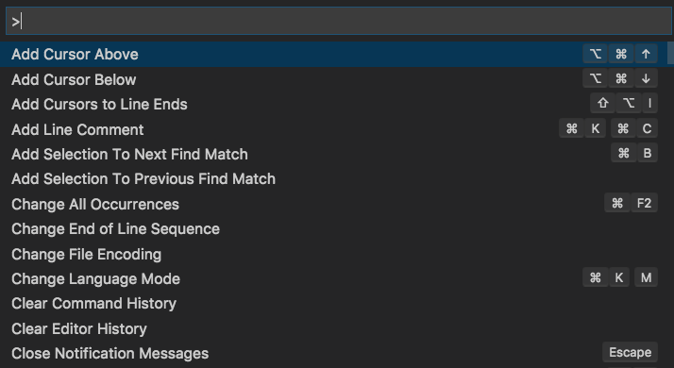
Command Palette
VS Code can be easily driven from the keyboard. The most important key combination to know is Ctrl+Shift+P, which brings up the Command Palette. This gives you access to all of the functionality of VS Code, including keyboard shortcuts for the most common operations.

Slide 22
Find a Project
Clone a project from Github using the Command Palette.
Note: If you haven't already logged into Git (or installed the Git Extension- VSCode) will prompt you for Git credentials and/or permission to install the extension.
In this example I will be using a repository used by a Microsoft container tutorial: https://github/burkeholland/python-products

Slide 23
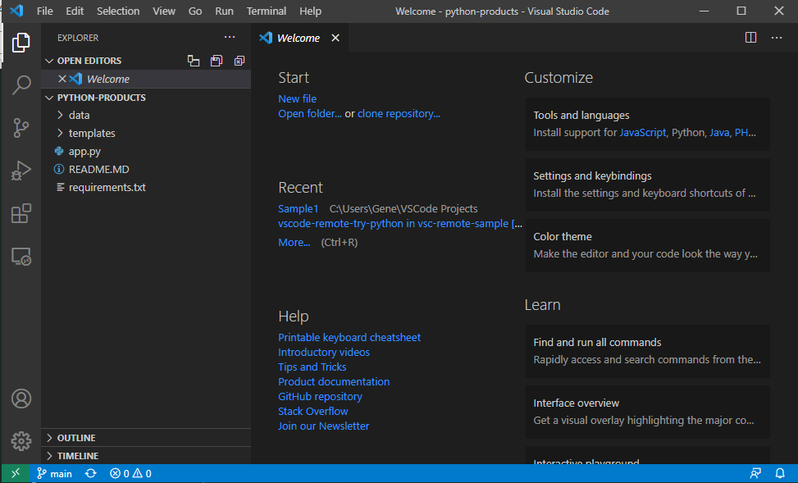
Open the Folder

Slide 24
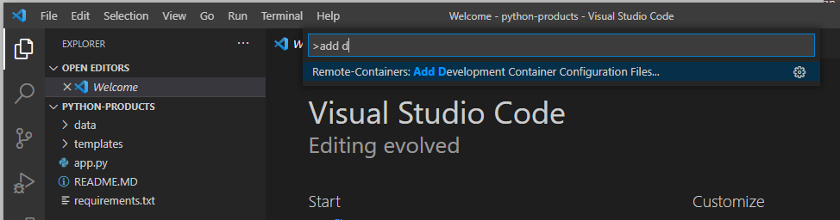
Create a Container Config
Add a container configuration to the cloned and downloaded project.
Open Command Palette and search for "Add Development Container Configuration Files"

Slide 25
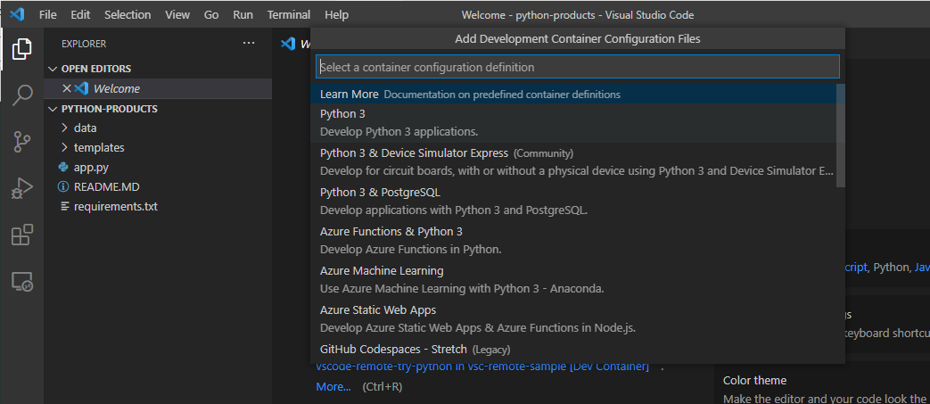
Container Recommendation
VSCode will make recommendations based on the files in the open folder.

Slide 26
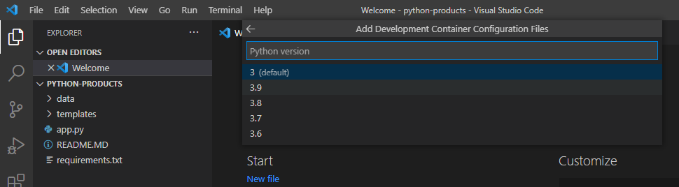
Python and Version
Select Python 3
The VSCode extension will prompt the version of Python to use.

Slide 27
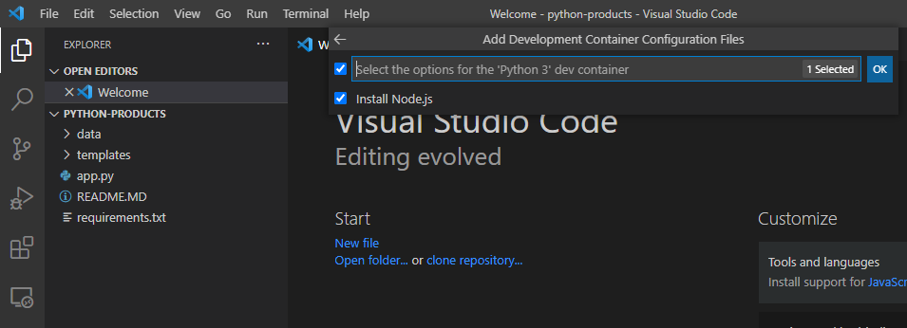
Container Options
The extension will then prompt to install any additional options.
Deselected Node.js

Slide 28
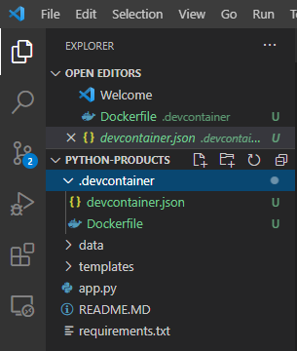
.devcontainer Folder
The container extension has created a .devcontainer folder containing two files.

Slide 29
Containerized Project
The presence of the .devcontainer folder with the two files committed to source control will allow other developers, who have VSCode with Remote Container Extensions and Docker installed, to open, execute and debug this project inside a container.

Slide 30
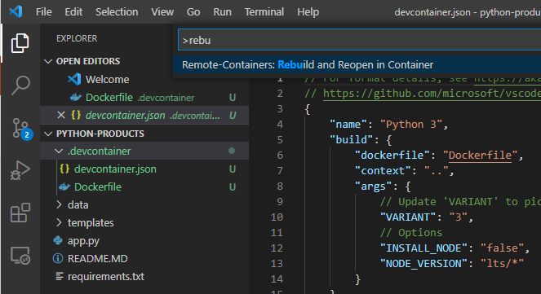
Build and Open
Next, we have to build the container and open the project in the container.

Slide 31
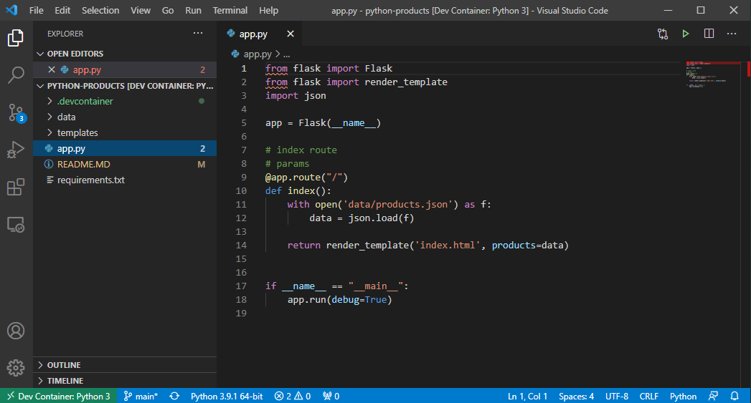
Working in the Container
The container with which VSCode is working is shown in the the new 'green' status indicator at the bottom left of the editor.

Slide 32
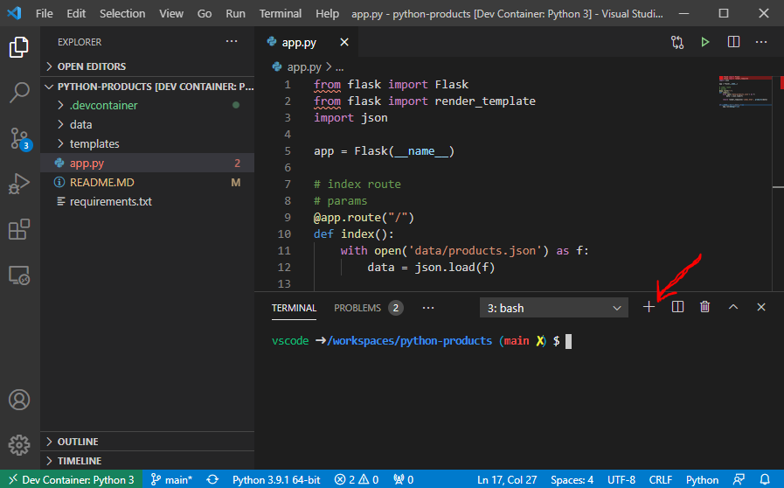
Open a Terminal
Click on the '+' button in the lower pane to open a new terminal.
The terminal is in the docker container, we are not on our local machine.

Slide 33
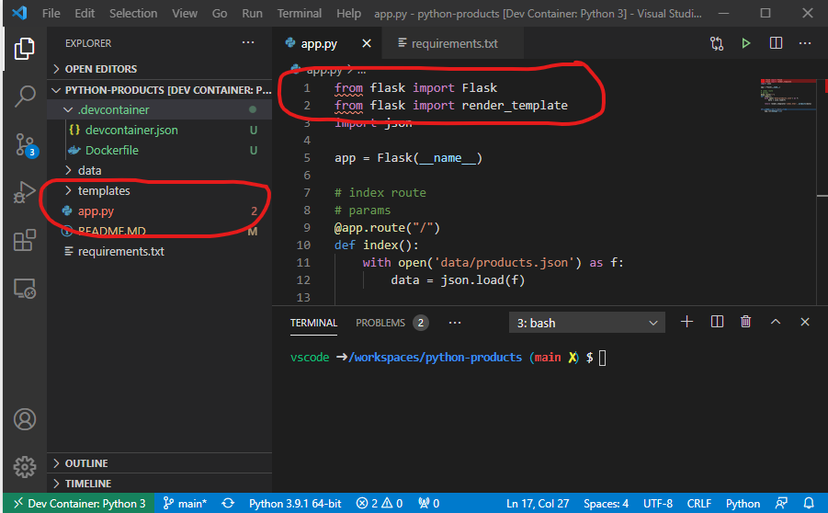
Build Errors
Compiling the small project has revealed two errors. The Flask framework is required.

Slide 34
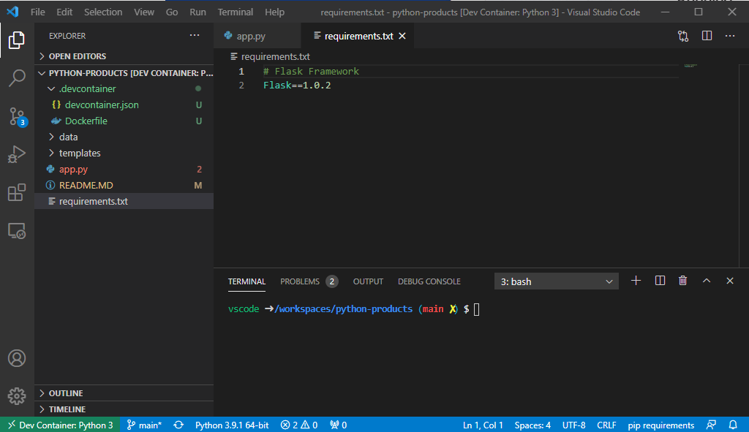
Dependencies
The sample project contains a 'requirements.txt' file.

Slide 35
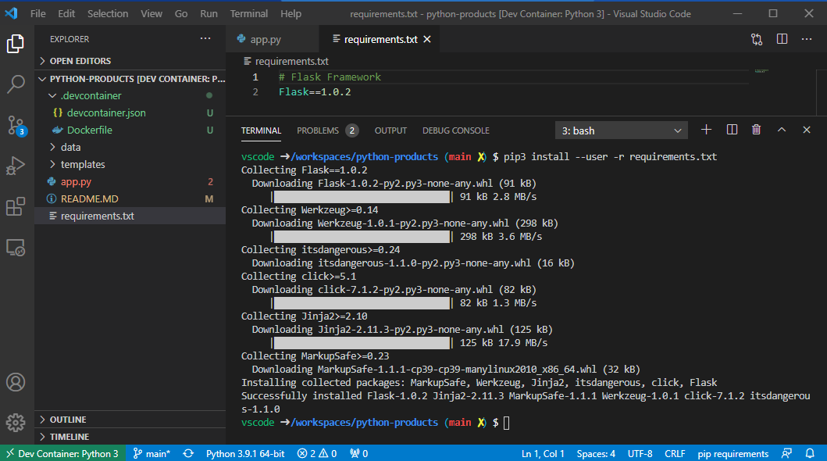
Pip3
Use Pip to install the dependencies identified in the requirements.txt file.

Slide 36
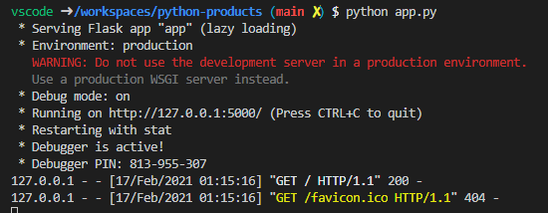
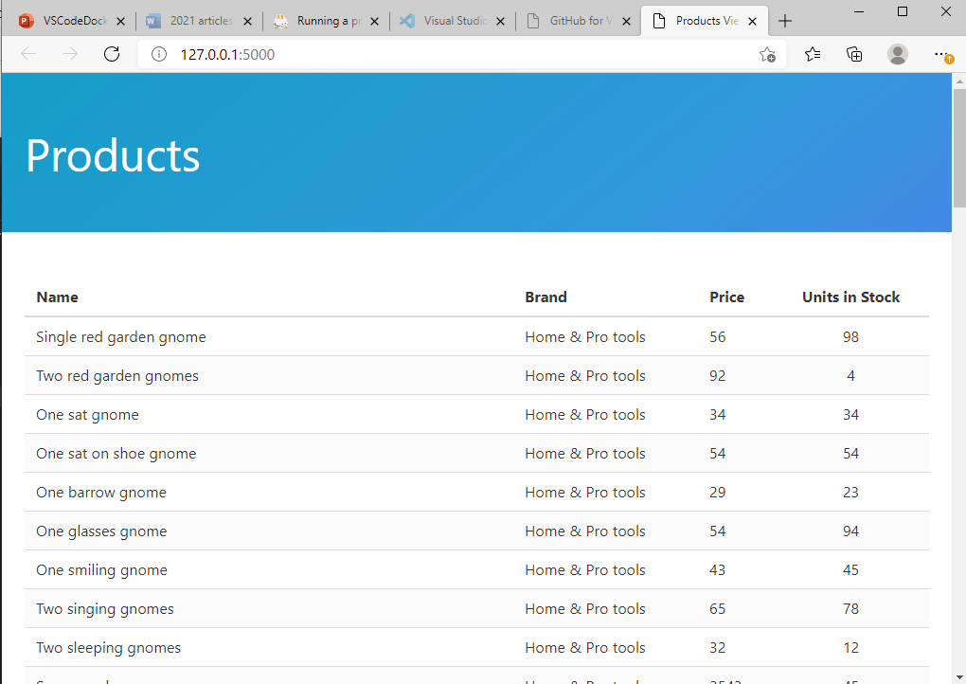
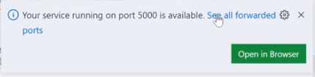
Run It!

Slide 37
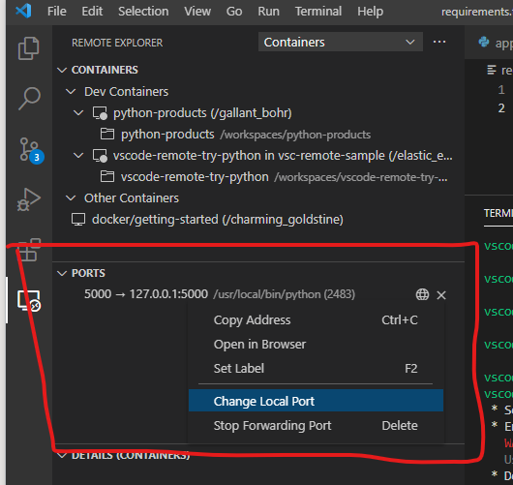
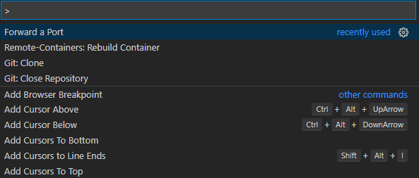
Port Forwarding
Each container is an isolated environment.
In order to acess any service or web page in the container, you need to forward the port to your local machine (the host).
Use the Command Palette to open the 'Ports' view.
You can re-map to a different local port as necessary.

Slide 38
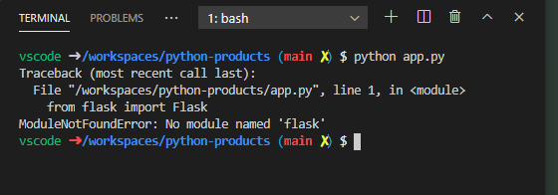
Rebuild and Redeploy Container
Rebuild and redeploy the container.
Run the application.

Slide 39
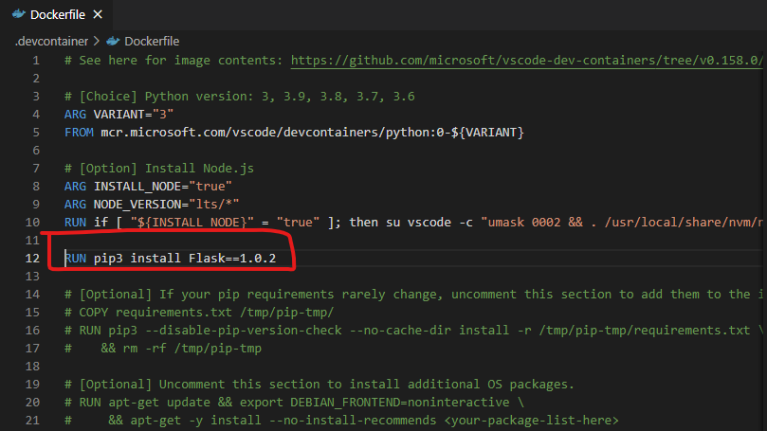
Add a Layer to the Image
You can modify the Dockerfile to add a layer to the image which installs the Flask framework.

Slide 40
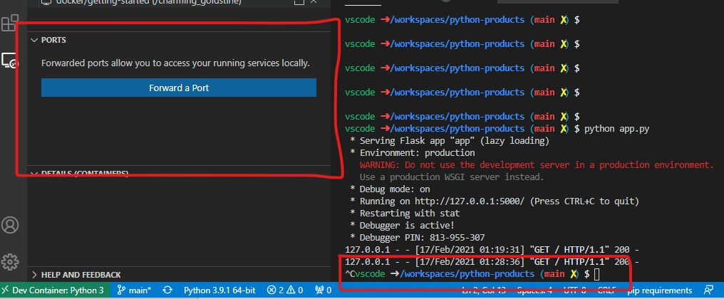
Stop the Application and the Port is No Longer Forwarded

Slide 41
devcontainer.json
Contains properties of the containerized project and allows you to modify aspects of the project and the environment without modifying the Docker file.

Slide 42
{
"name": "Python 3",
"build": {
"dockerfile": "Dockerfile",
"context": "..",
"args": {
// Update 'VARIANT' to pick a Python version: 3, 3.6, 3.7, 3.8, 3.9
"VARIANT": "3",
// Options
"INSTALL_NODE": "false",
"NODE_VERSION": "lts/*"
}
},
// Set *default* container specific settings.json values on container create.
"settings": {
"terminal.integrated.shell.linux": "/bin/bash",
"python.pythonPath": "/usr/local/bin/python",
"python.linting.enabled": true,
"python.linting.pylintEnabled": true,
"python.formatting.autopep8Path": "/usr/local/py-utils/bin/autopep8",
"python.formatting.blackPath": "/usr/local/py-utils/bin/black",
"python.formatting.yapfPath": "/usr/local/py-utils/bin/yapf",
"python.linting.banditPath": "/usr/local/py-utils/bin/bandit",
"python.linting.flake8Path": "/usr/local/py-utils/bin/flake8",
"python.linting.mypyPath": "/usr/local/py-utils/bin/mypy",
"python.linting.pycodestylePath": "/usr/local/py-utils/bin/pycodestyle",
"python.linting.pydocstylePath": "/usr/local/py-utils/bin/pydocstyle",
"python.linting.pylintPath": "/usr/local/py-utils/bin/pylint"
},
// Add the IDs of extensions you want installed when the container is created.
"extensions": [
"ms-python.python"
],
// Use 'forwardPorts' to make a list of ports inside the container available locally.
// "forwardPorts": [],
// Use 'postCreateCommand' to run commands after the container is created.
// "postCreateCommand": "pip3 install --user -r requirements.txt",
// Comment out connect as root instead. More info: https://aka.ms/vscode-remote/containers/non-root.
"remoteUser": "vscode"
}

